Slide 1
Employing Adversarial Machine Learning and Computer Audition for Smartphone-Based Real-Time Arrhythmia Classification in Heart Sounds
Aditya Kendre
Cumberland Valley HS
Mechanicsburg, PA, USA
Notes:
Project ID and Title • The following should be included: o Project ID. This ID will be provided by Society for Science & the Public upon submission of ISEF paperwork. o Project Title o Finalist Name (s) o School(s) o City, State, Province, Country

Slide 2
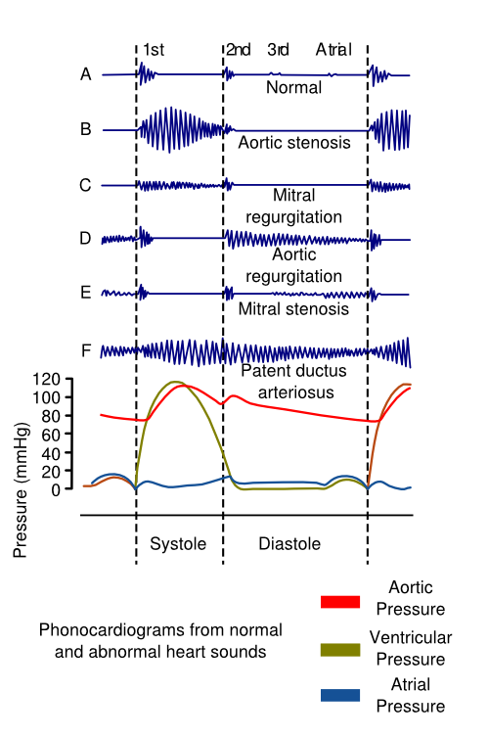
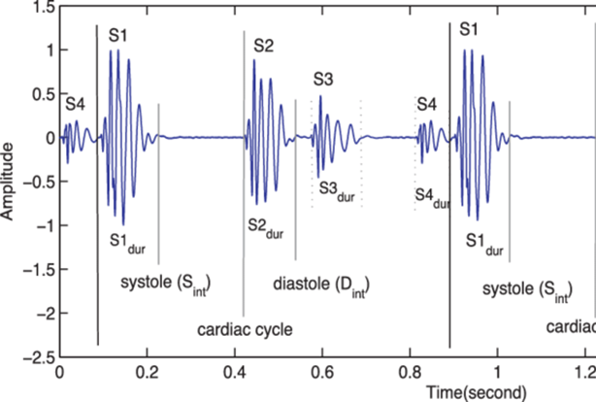
Introduction
Although heart sound databases do exist, these datasets are still limited by the number of pathologies that are collected, often having to divide the dataset into two categories: normal and abnormal. Currently, only three major supervised PCG datasets exist: PhysioNet Classification of Heart Sound Recording Challenge dataset, PASCAL Heart Sound Challenge dataset, and the Heart Sound and Murmur Library. These PCG datasets have a limited number of samples and do not cover the complete range of pathologies that are likely to be encountered in clinical settings.
The main challenge of ineffective heart sound detection stems from an analysis of noisy heartbeats, e.g., background noise. For clean datasets, e.g., the PhysioNet Challenge dataset, a varieties time and frequency of methods converged on localization accuracy of 96.9% (Fernando et al.) and 96.0% classification accuracy (Mostafa et al.). For large datasets with noisy signals, e.g., the PASCAL Challenge dataset, the performance of time and frequency methods remained inconsistent at a localization accuracy of 93.3% (Singh et al.) and 93.3% classification accuracy (Singh et al.).
From the viewpoint of practical applications, the development of computationally efficient solutions is extremely important to the success of a model's deployment. Many studies have negated to comment on the practicality of their proposed methods. From our research, we have concluded only two studies have noted their time efficiency, (Fernando et al.) and (Messner et al.). The fastest model processed 1000 heart state classifications in 56.88 seconds (Fernando et al.), suggesting the model can process 18 bps. The average heart rate of a human heart is around 60-100 bps; thus, current models need severe optimization to achieve near to real-time analysis. These results are excluding the classification of heart arrhythmias.
Thus, the problem of computationally efficient and accurate classification of noisy heartbeats, especially with datasets with a variety of pathologies still remains a problem.
Figure 3. Representation of different abnormalities in sound and pressure.
Figure 2. Illustrates the S1, S2, S3, and S4 biomarkers of heart sounds.

Slide 3
Framework: Data Management & Model Development

Slide 4
Framework: Data Management & Model Development

Slide 5
Framework: Model Learning & Deployment

Slide 6
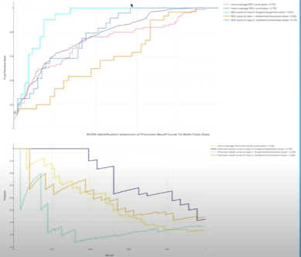
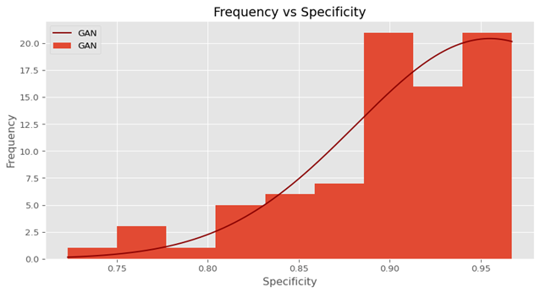
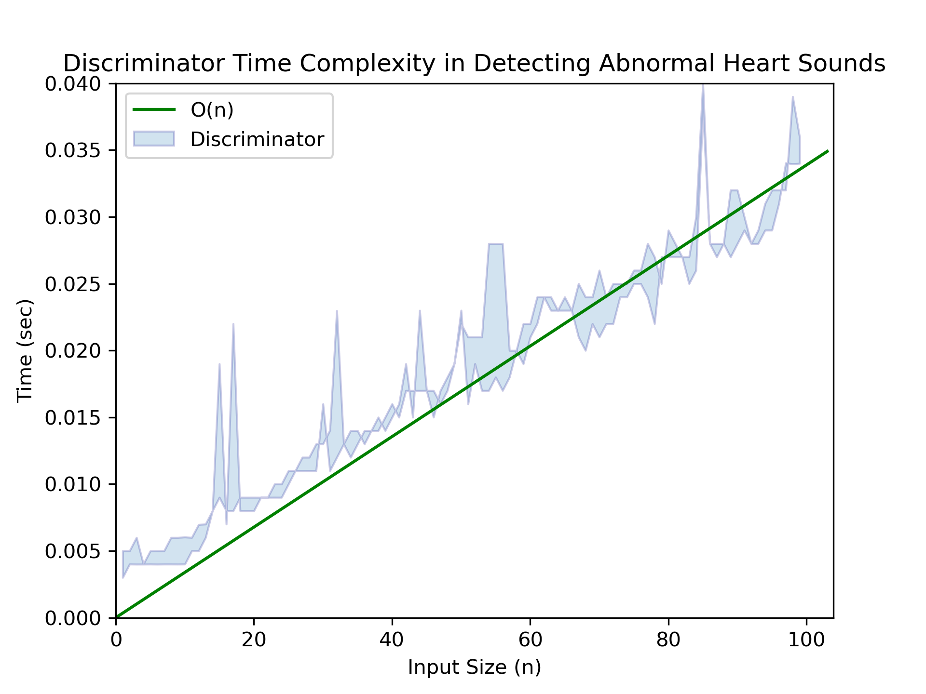
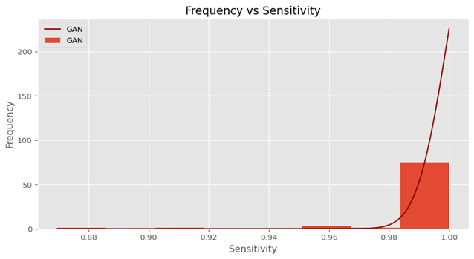
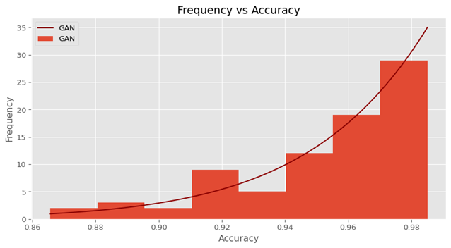
Findings
Figure 17. Time complexity of discriminator in classifying heart sounds.
Figure 13. Plot of testing set results on specificity, sensitivity, and accuracy.

Slide 7
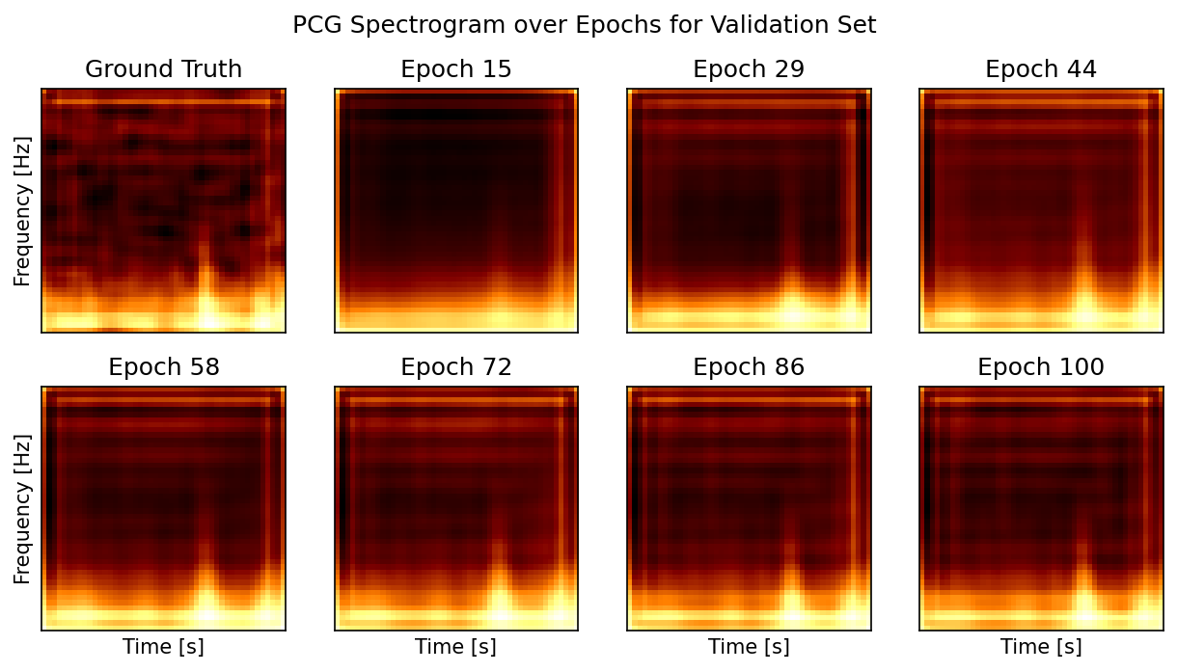
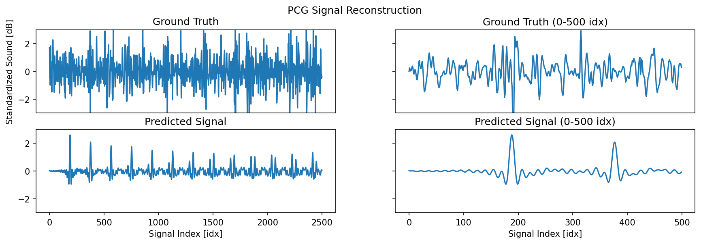
Findings

Slide 8
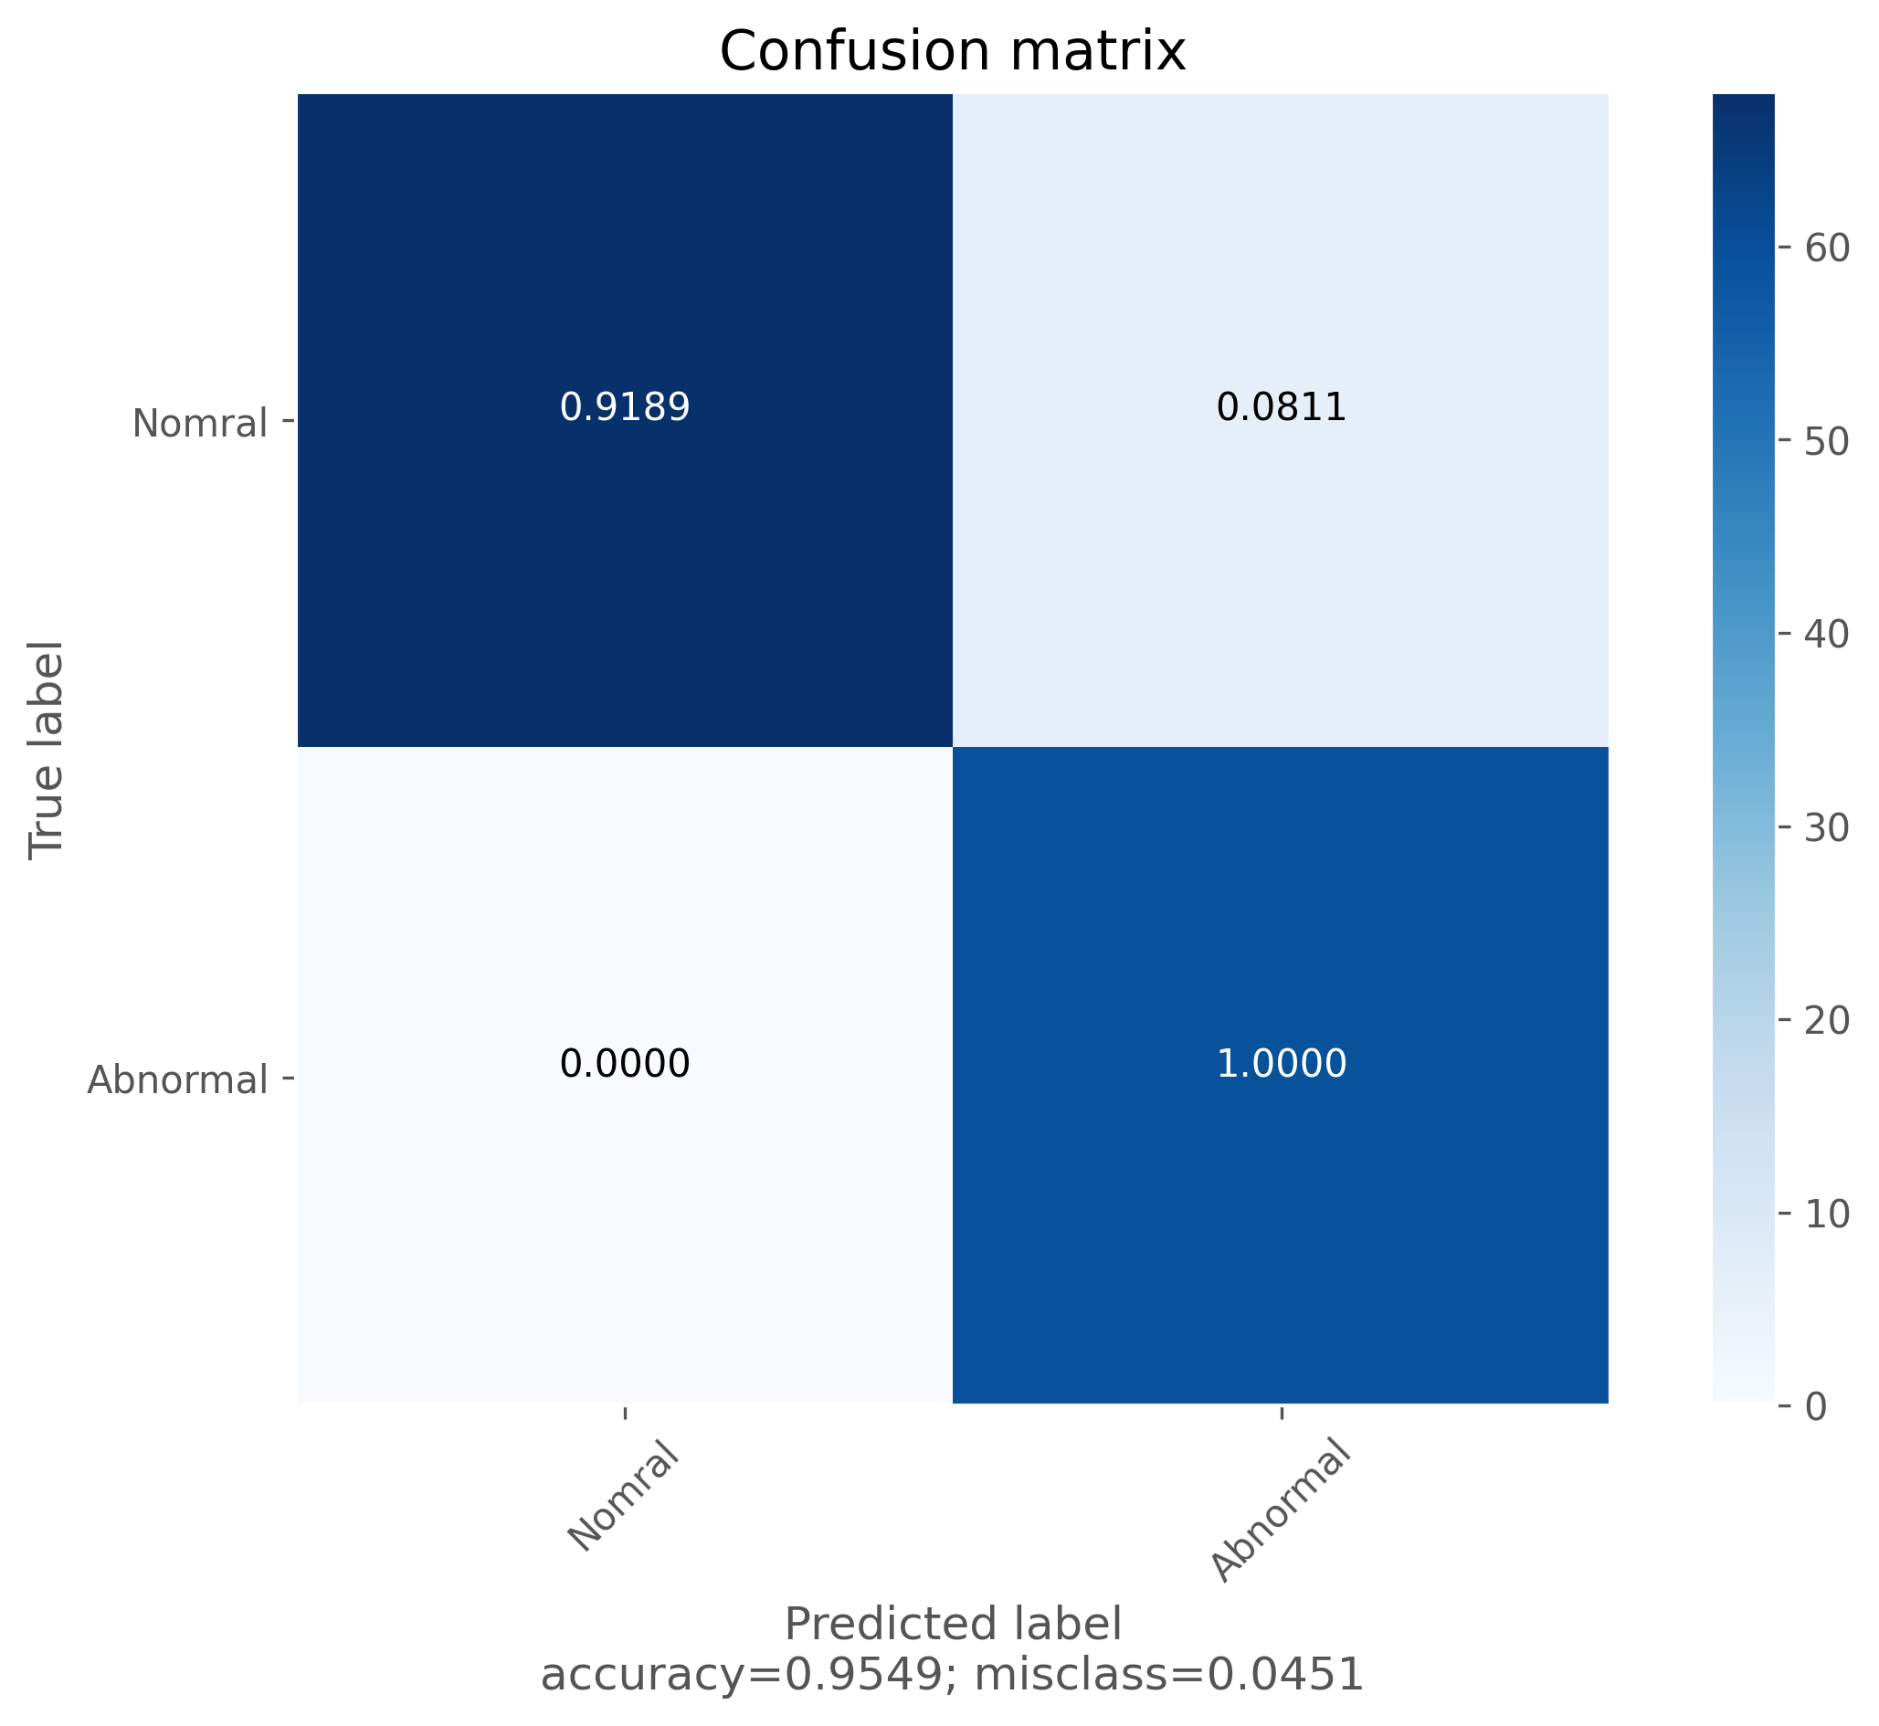
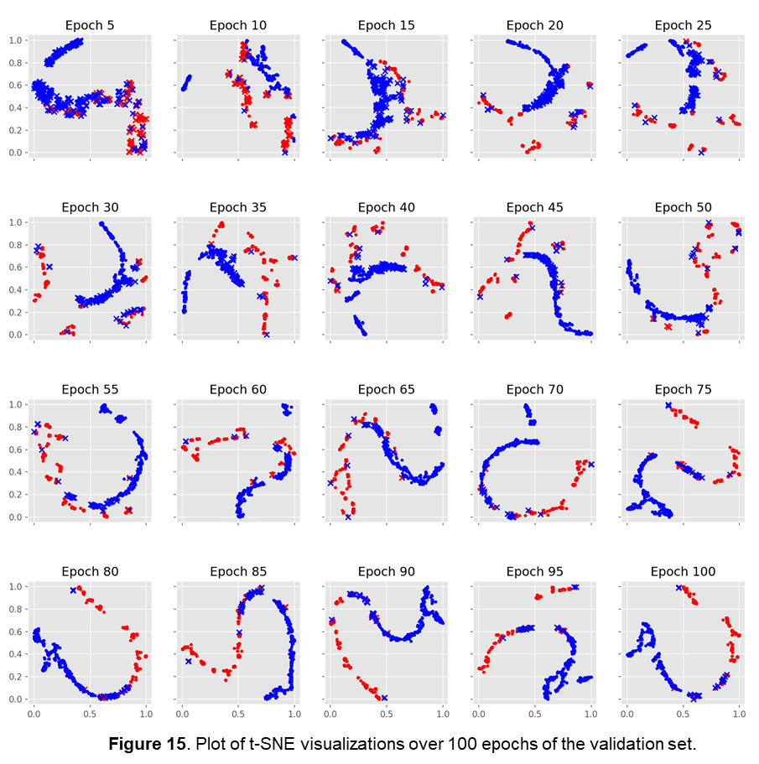
Findings
Figure 16. Matrix of accuracy between labels in the dataset.

Slide 9
Study | Classification techniques | Beat types | Dataset | Time Efficiency | Results
Nogueira et al. | Classification of heat images generated from MFCC and time features using SVM, KNN, CNN, and random forest | Normal and abnormal heart sound | PhysioNet CinC challenge, 2016 | - | Sensitivity: 96.47% Specificity: 72.65% Overall Score: 84.56%
Potes et al. | Time, spectrum, MFCC- based features, CNN, AdaBoost-Abstain classifier, and ensemble classifier | Normal and abnormal heart sounds | PhysioNet CinC challenge, 2016 | - | Sensitivity: 77.81% Specificity: 92.42% Overall Score: 86.02%
Ortiz et al. | SVM using time, MFCC, DWT, and wavelet | Normal and abnormal heart sounds | PhysioNet CinC challenge, 2016 | - | Test Score: 82.4%
Tang et al. | ANN using time, kurtosis, MFCC, energy, power spectrum cyclostationary features | Normal and abnormal heart sounds | PhysioNet CinC challenge, 2016 | - | Sensitivity: 80.7-81.2%, Specificity: 82.9- 85% Overall Score: 81.8- 83.6%
Rubin et al. | CNN using heat maps generated using MFCC features | Normal and abnormal heart sounds | PhysioNet CinC challenge, 2016 | - | Specificity: 95% Sensitivity: 73% Overall Score: 84%
Singh et al. | Time domain, frequency domain, cepstrum, statistical features, Bayes Net, nave Bayes, GSD, and Logit Boost | Normal heart sounds and murmurs | PASCAL Datasets: A & B | - | Specificity: 93.3% Sensitivity: 93.3% Accuracy: 93.3%
Krishnan et al. | Embedding Layers, CNN, DNN | Normal and abnormal heart sounds | PhysioNet CinC challenge, 2016 | - | Sensitivity: 86.73% Specificity: 84.75% Accuracy: 85.65% Precision: 82.52% F1 Score: 84.58%
Fernando et al. | BiLSTM | S1, S2, None | PhysioNet CinC challenge 2016 | 17 classifications per second | Sensitivity: 97.2% Specificity: 97.5% Accuracy: 96.9% PPv: 96.3% F1 Score: 96.7%
Messner et al. | RNN | S1, S2, None | PhysioNet CinC challenge, 2016 | 8 classifications per second | Sensitivity: 96.1% Specificity: 95.1% F1 Score: 95.6%
Proposed Method | GAN with CNN | Normal and abnormal heart sounds | PhysioNet CinC challenge 2016 & PASCAL Datasets: A & B | ~1000 classifications per second | Sensitivity: 100.0% Specificity: 96.67% Accuracy: 98.75%
Findings

Slide 10
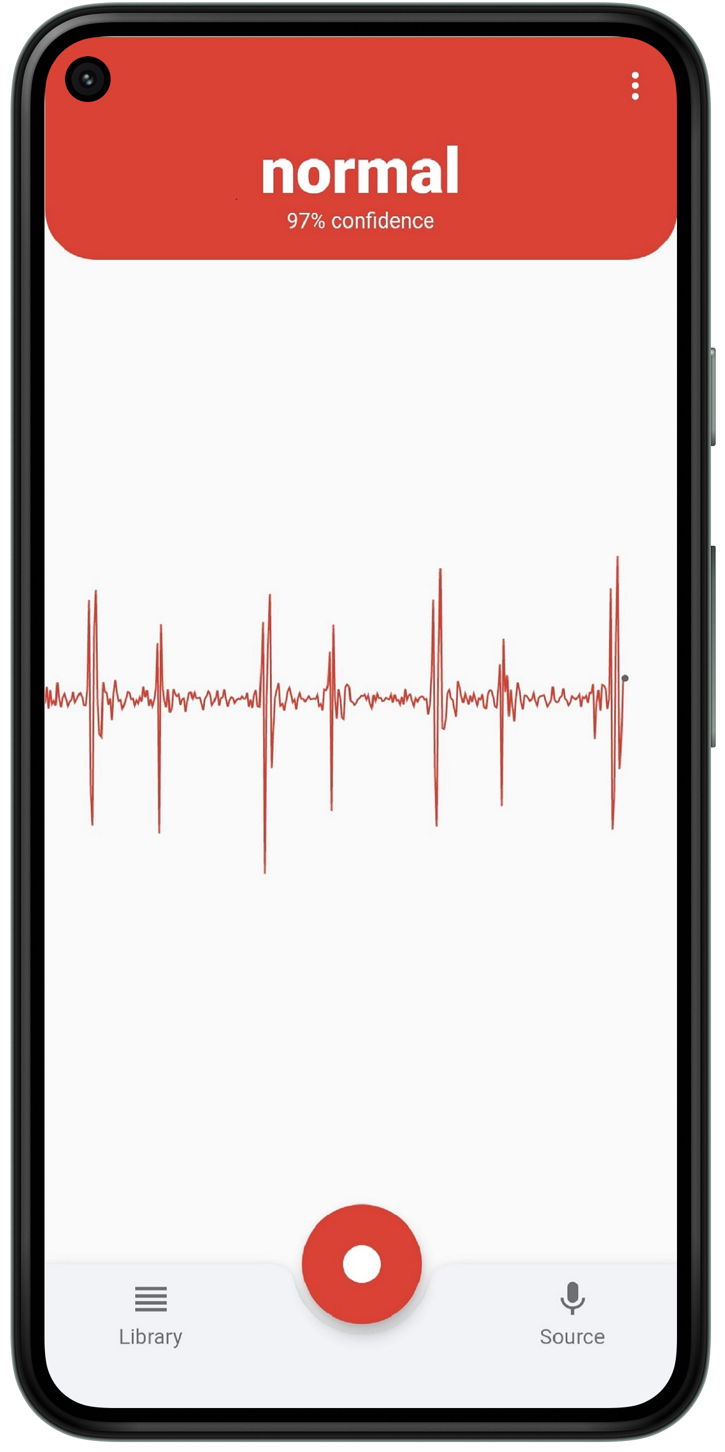
Conclusions
We proposed a Generative Adversarial Network (GAN), composed of a Dense Generator and a Convolutional Neural Network (CNN) Discriminator to detect abnormal heart sounds in a recording. The model achieved an accuracy of 94.98%, a specificity of 90.30%, and a sensitivity of 99.52% on the testing set. The previous state-of-the-art achieved an accuracy of 86.02%, a specificity of 77.81%, and a sensitivity of 94.24%. This data, along with results from the t-test revealed that the proposed alternative hypothesis was correct and that the null hypothesis should be rejected. This is because the proposed method reached better performance than the previous state-of-the-art methods. Additionally, the model attained a staggering ~2500 classification per second in the worst-case scenario. This is because of the nature of the CNN architecture; unlike other methods, the CNN's reduce the data dimensionality as it forward propagates through the model. Furthermore, the proposed method showed real-world deployment capabilities for autonomous heart sound abnormality detection with recordings collected from a phone microphone. This test shows extremely promising results for future applications and integrations. We also set out to introduce new pathologies for increased arrhythmia labels in classification. We proposed using a VQGAN for constructing PCG signals from existing ECG datasets that contain a surplus amount of arrhythmia-specific data. The results were promising, in that the VQGAN discriminator was able to construct the general shape of the PCG spectrogram, but missed import details in the fluctuation of important biomarkers (S1 and S2). This caused the PCG waveform representation extracted from the PCG spectrogram to miss rapid oscillations present in the biomarkers. The object of this study was to create a fast and accurate end-to-end heart sound arrhythmia detection system, capable of detecting abnormalities in real-time without specialized equipment. While also increasing the number of cardiovascular pathologies classified. With the data shown, our proposed method accomplishes exemplary statistics in abnormalities detection and shows promising results in increased arrhythmia construction. Hopefully, this study will shed light on PCG construction techniques and give birth to applications with autonomous abnormality detection.
Notes:
Include about parical application

Slide 11
References
Ali, M. N., El-Dahshan, E.-S. A., & Yahia, A. H. (2017). Denoising of Heart Sound Signals Using Discrete Wavelet Transform. Circuits, Systems, and Signal Processing, 36(11), 4482–4497. https://doi.org/10.1007/s00034-017-0524-7
Babu, K. A., Ramkumar, B., & Manikandan, M. S. (2017). S1 and S2 heart sound segmentation using variational mode decomposition. TENCON 2017 - 2017 IEEE Region 10 Conference, 1629–1634. https://doi.org/10.1109/TENCON.2017.8228119
Latif, S., Usman, M., Rana, R., & Qadir, J. (2020). Phonocardiographic Sensing using Deep Learning for Abnormal Heartbeat Detection. ArXiv:1801.08322 [Cs]. http://arxiv.org/abs/1801.08322
Messner, E., Zohrer, M., & Pernkopf, F. (2018). Heart Sound Segmentation—An Event Detection Approach Using Deep Recurrent Neural Networks. IEEE Transactions on Biomedical Engineering, 65(9), 1964–1974. https://doi.org/10.1109/TBME.2018.2843258
PhysioNet/CinC Challenge 2016: Training Sets. (n.d.). Retrieved January 11, 2021, from https://archive.physionet.org/pn3/challenge/2016/
Smilkov, D., Thorat, N., Kim, B., Viégas, F., & Wattenberg, M. (2017). SmoothGrad: Removing noise by adding noise. ArXiv:1706.03825 [Cs, Stat]. http://arxiv.org/abs/1706.03825
Subasi, A. (2019). Biomedical Signals. In Practical Guide for Biomedical Signals Analysis Using Machine Learning Techniques (pp. 27–87). Elsevier. https://doi.org/10.1016/B978-0-12-817444-9.00002-7
Thoms, L.-J., Collichia, G., & Girwidz, R. (2019). Real-life physics: Phonocardiography, electrocardiography, and audiometry with a smartphone. Journal of Physics: Conference Series, 1223, 012007. https://doi.org/10.1088/1742-6596/1223/1/012007
Zhang, W., Han, J., & Deng, S. (2017). Heart sound classification based on scaled spectrogram and partial least squares regression. Biomedical Signal Processing and Control, 32, 20–28. https://doi.org/10.1016/j.bspc.2016.10.004

